Slide 1
Simple relaxation
Ing. Lenka Slezáková

Slide 2
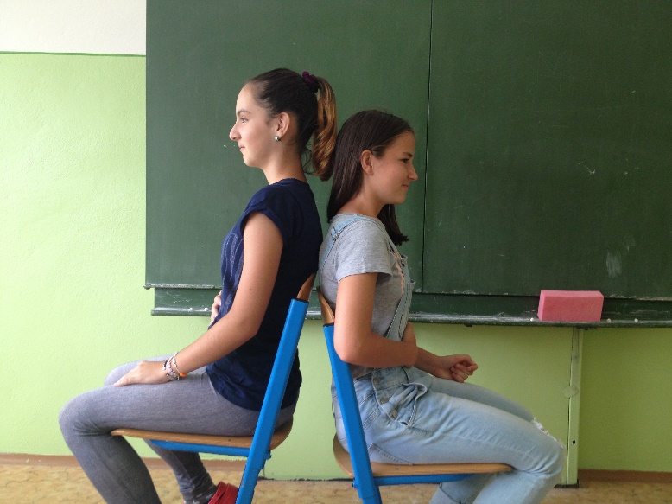
Begin by sitting comfortably, balanced, and relaxed (if seated in a chair, feet on the ground). Breathe easy and from the abdomen/”belly breathing” (not chest breathing). You can sit on a ball as well.

Slide 3
Practice a few deep breaths with the group.

Slide 4
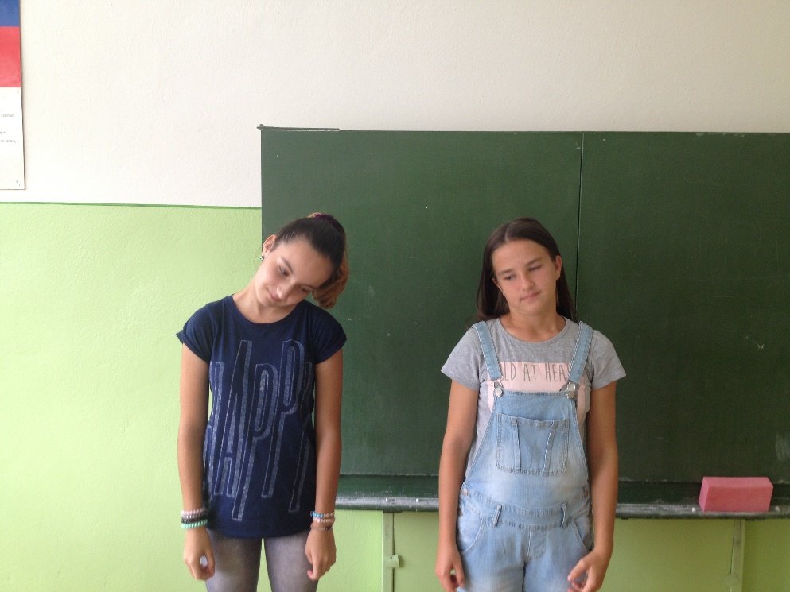
Rotate the head in easy, slow 3-5 circles; change direction and rotate in slow, easy 3 - 5 circles. Breath in slowly and move very slowly.

Slide 5
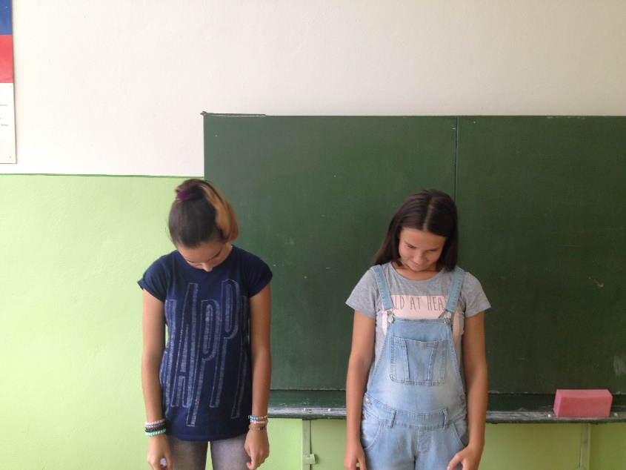
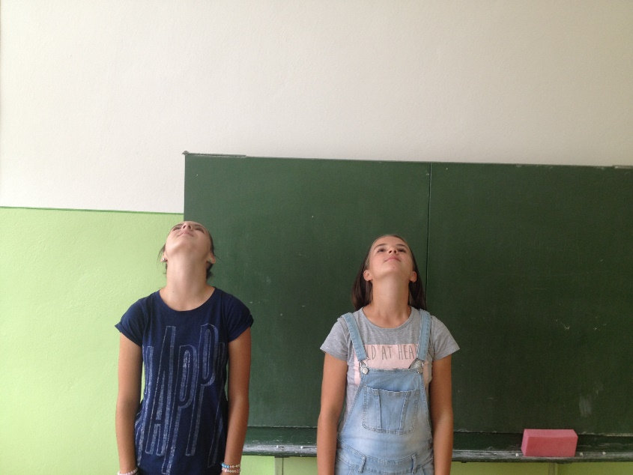
Look up; tilt your head way back. Look down; put your chin on your chest. Repeat 3- 5 times.

Slide 6
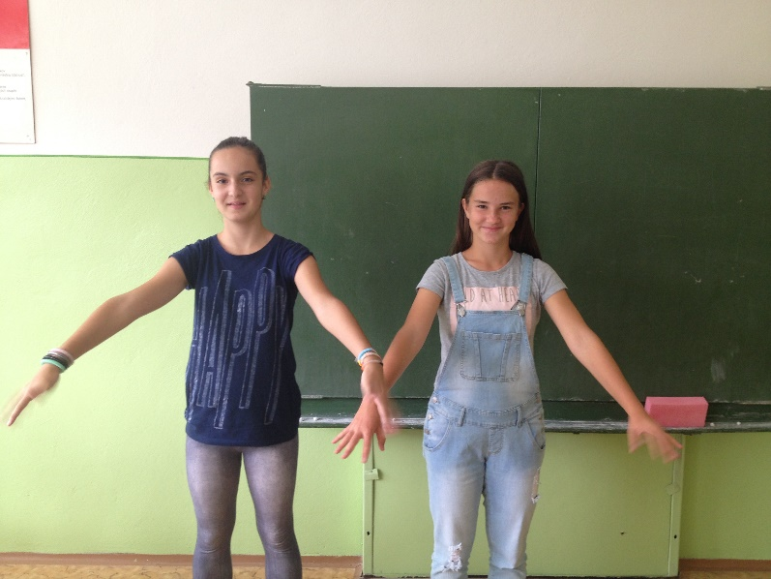
Drop your arms and hands to the side and shake them gently and easily.

Slide 7
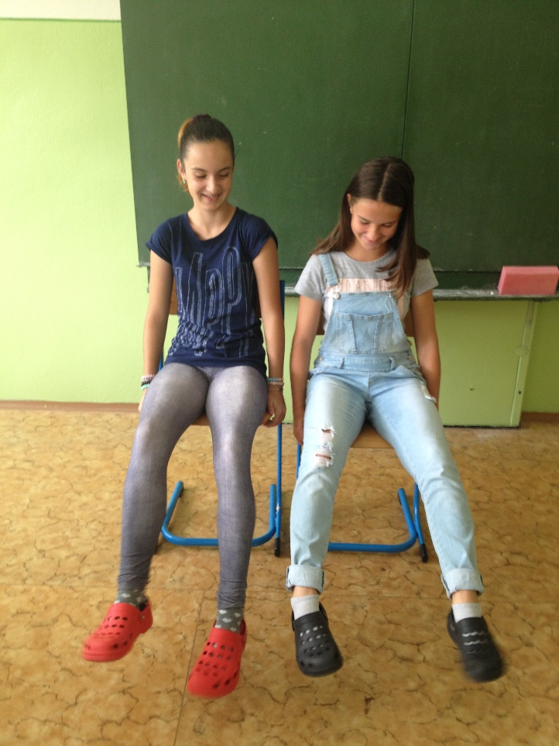
Raise your feet off the floor and gently and easily shake the knees.

Slide 8
Practice a few deep breaths with the group

Slide 9
Thank you for your attention.
Resource: www.edutopia.org/.../stw-glenview-stress-reduction-activities.pdf

