Slide 1
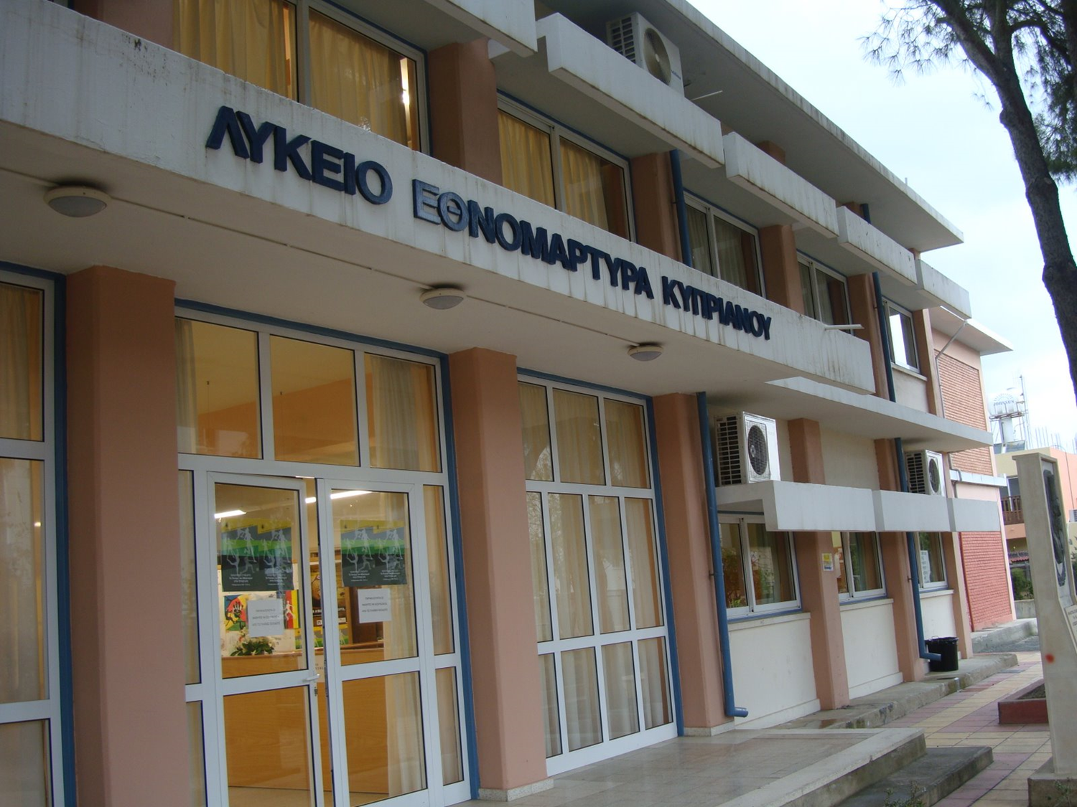
Volunteerism and Self-Esteem
A research

Slide 2
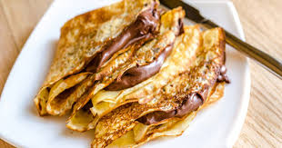
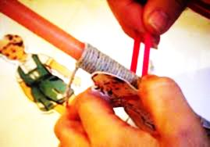
The following research was held in our school from February to April 2016. 85 students took part in four voluntary actions. These were the making and sale of crepes for raising money for needy students and the decoration and sale of Easter candles for the same purpose. Students also donated blood and participated in tree planting. All the children who are here today in Lithuania were engaged in the activities.

Slide 3
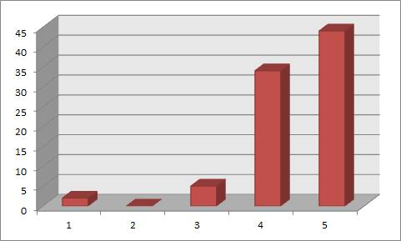
1st To what extent are you familiar with the term volunteerism?
Students of our school evidently know about volunteering as 78 of the 85 responded that they are aware of what it is.
Not at all Little Average Much Very Much

Slide 4
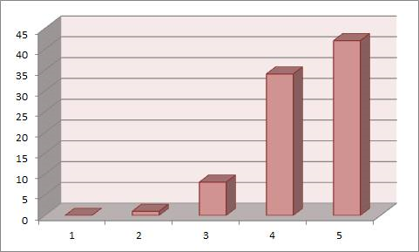
2nd To what extent do you know the term ^{"self-esteem” ?}
The same applies to the term “self-esteem” as the answers were found to be of the same range as with the term “volunteerism”.
Not at all Little Average Much Very Much

Slide 5
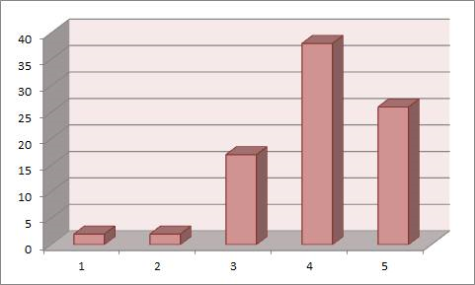
3rd To what extent are you interested in participating in group efforts to resolve contemporary problems?
Students of our school showed enough interest in voluntary work and in solving contemporary problems as only four students out of the 85 showed little or no interest.
Not at all Little Average Much Very Much

Slide 6
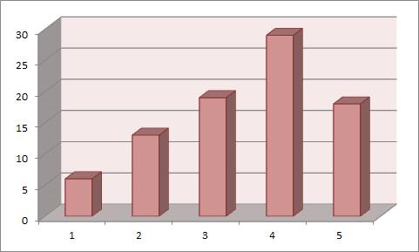
To what extent do you believe that volunteering can help prevent teens from getting involved in dangerous situations?
4th
Most students argued that voluntary work can prevent children from getting involved in bad companies although a small number of students argued the risks are still lurking. This makes sense when we consider that we are talking about teenagers.
Not at all Little Average Much Very Much

Slide 7
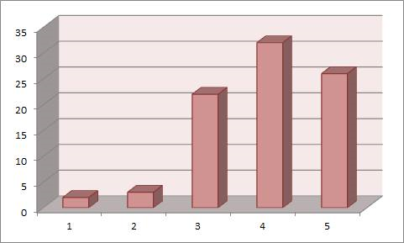
5th To what extent do you believe that through volunteerism young people's free time is used creatively?
The answers to the above question indicate that the highest percentage of students who participated believe that voluntary action is creative time.
Not at all Little Average Much Very Much

Slide 8
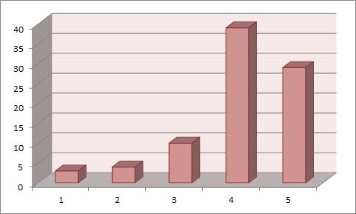
6th To what extent do you feel that through volunteerism you participate in creative work?
At the same time the majority of students believe that their participation in voluntary actions makes them socialize greatly or relatively well.
Not at all Little Average Much Very Much

Slide 9
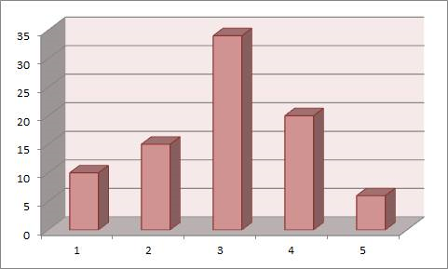
To what extent do you believe that the school promotes voluntary actions?
7th
As far as the role of the school regarding voluntary work, students argued that the school is not doing enough. In fact 10 students felt that the school does not promote voluntary actions although the research was conducted during some volunteering activities by school. 15 students felt that the school does not promote enough voluntary actions and 34 felt so at an average degree. Finally 26 students felt that the school promotes volunteering ranging from much to very much.
Not at all Little Average Much Very Much

Slide 10
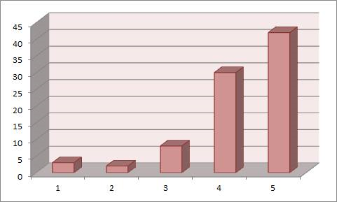
8th To what extent do you think that participation in voluntary work makes you a better person?
To this question, students responded positively that voluntary activities make you a better person. In fact, four out of five respondents answered much or too much.
Not at all Little Average Much Very Much

Slide 11
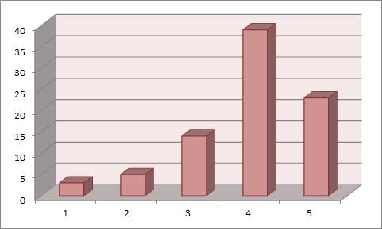
9th To what extent do you believe that voluntary actions improve young people's self esteem and self image?
The same applies to this question because our students supported greatly that volunteerism improves young people’s self-image and self-esteem .
Not at all Little Average Much Very Much

Slide 12
10th What/which bodies or organizations do you believe young people get informed about volunteerism?
School | State | Church | Family | National Organizations
54 | 25 | 39 | 48 | 25

Slide 13
11th What do you think someone gains out of voluntary work?
The most prevalent words in students’ answers were the following:
Self-Esteem | Friends | Social network | Social status | Experiences
38 | 45 | 35 | 19 | 35

Slide 14
12th What feelings do you experience when contributing to voluntary work?
The words most
prevalent in students' responses were ...
► confidence
► feeling useful
► contributing to the whole
► joy

Slide 15
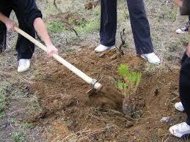
The above research reveals that students of our school are very much willing to participate in voluntary work or activities.

Slide 16
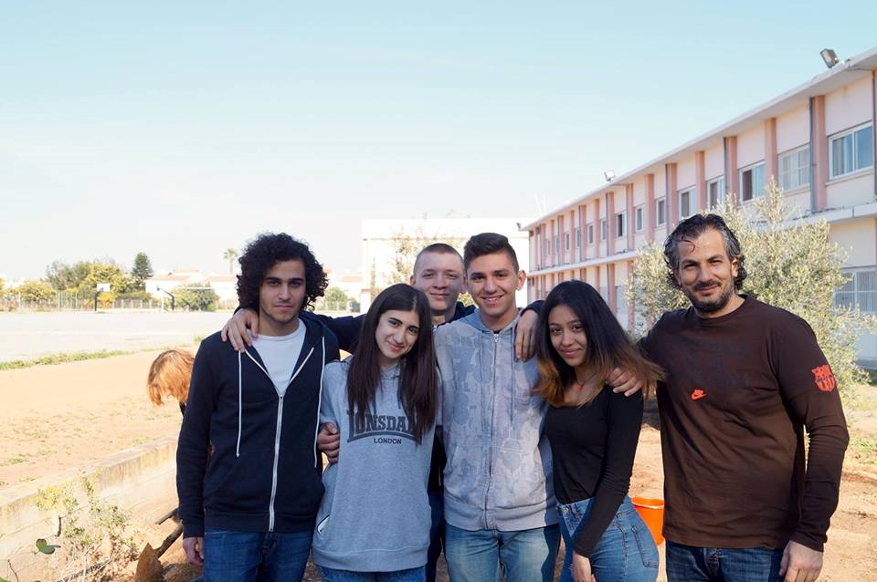
It is evident that students know what volunteerism is and how important it is for self-esteem.

Slide 17
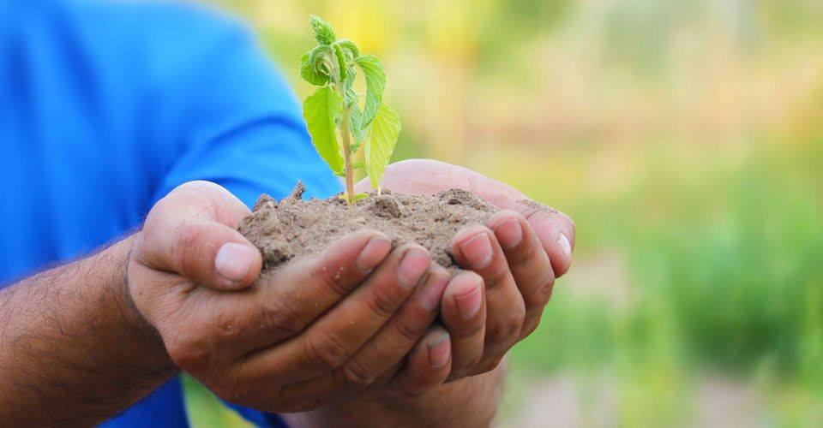
Αt the same time they knowledge the role of social institutions in supporting and organizing voluntary actions.

Slide 18
The students find that the school plays an important role in volunteering since in the question "What/which bodies or organizations do you believe young people get informed about volunteerism?” we had 54 students who said so. That was the highest percentage of any other institution.

Slide 19
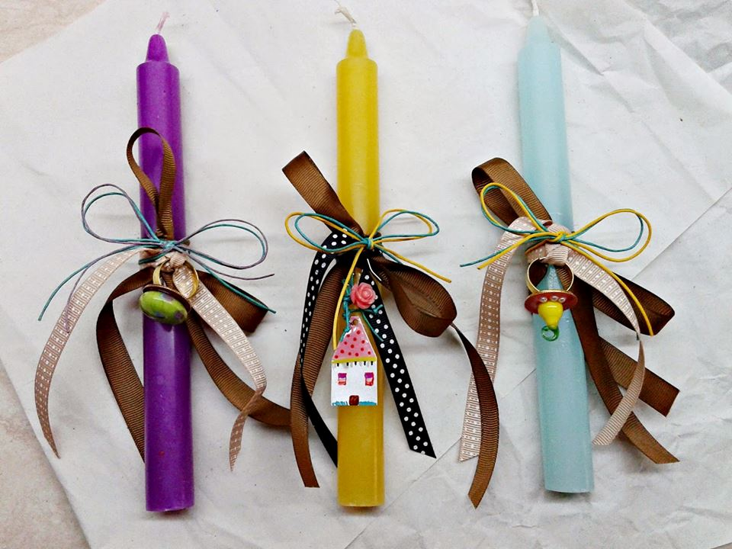
The answers to the question 7 about whether the school promotes voluntary work suggest indirectly and contradictorily, the students’ need and demand to offer more even if this is done with mainly the school being the leader.

Slide 20
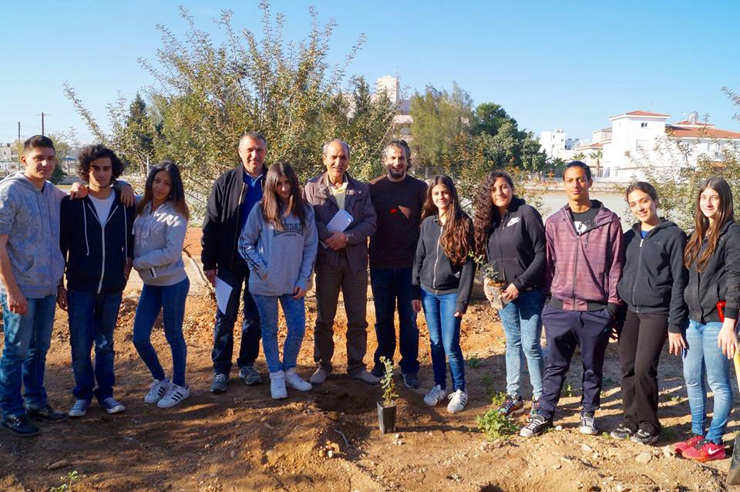
Finally we, the ERASMUS PLUS team of 2016 with our participation in voluntary work we have definitely realized how essential volunteerism is for the improvement of our self-image and self-esteem .

Slide 21
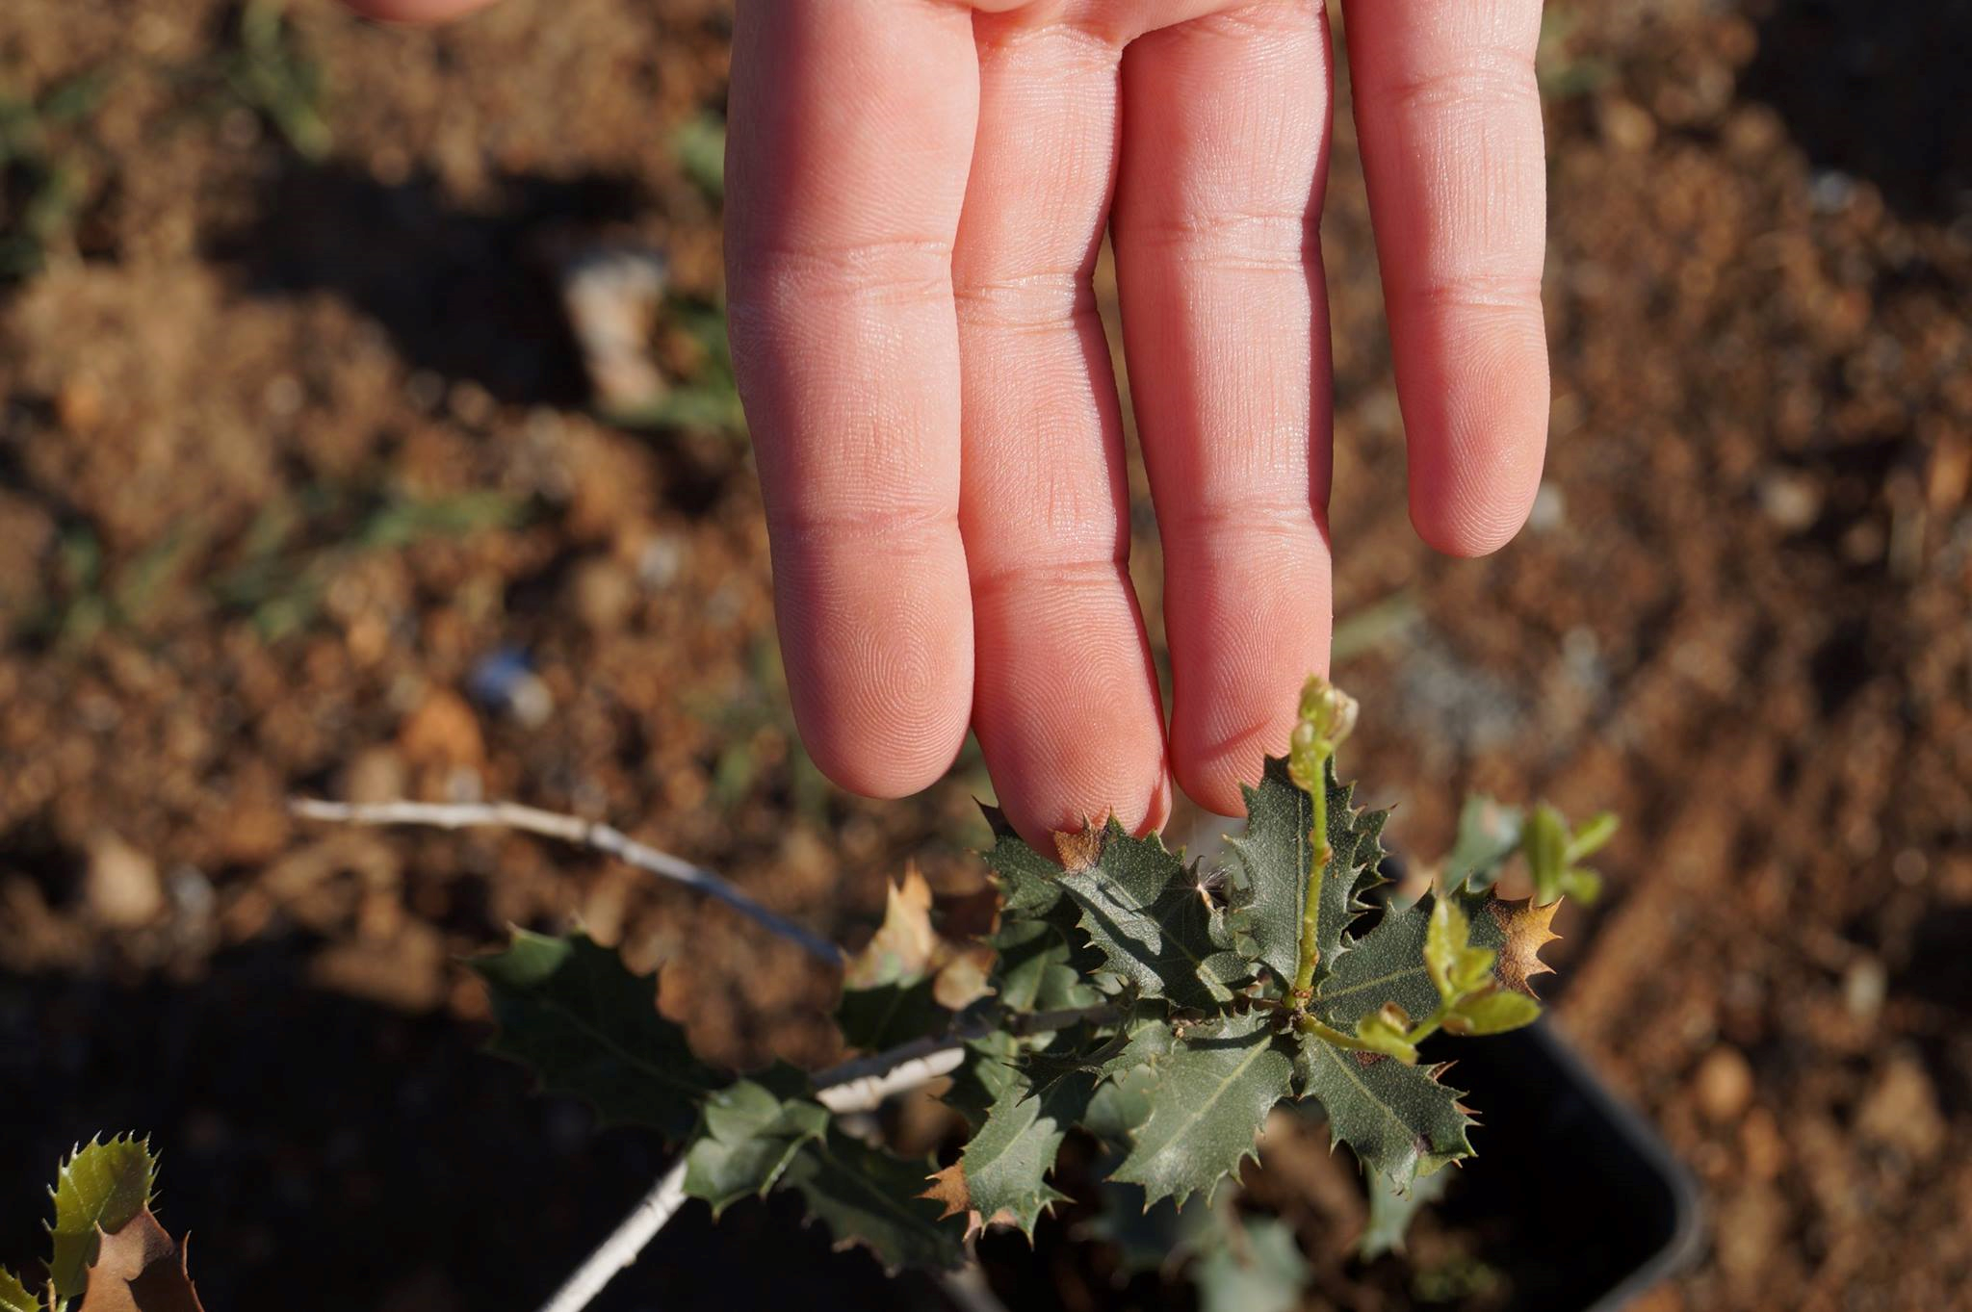
Thank you!

